Slide 1

Swing Components
Basic Frame
Basic Components
Popup Dialogs
Menus

Slide 2
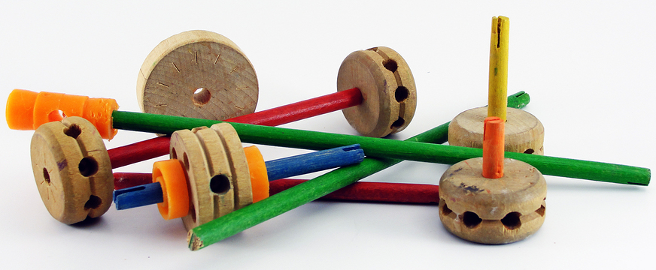
See Also
http://web.mit.edu/6.005/www/sp14/psets/ps4/java-6-tutorial/components.html
http://www.tutorialspoint.com/swing/swing_controls.htm
Notes:
Some additional information on concurrency

Slide 3
Basic Panel
import javax.swing.JButton;
import javax.swing.JFrame;
import javax.swing.JPanel;
public class Tinker {
public static void main(String[] args) {
JButton bt = new JButton("Press Me");
JPanel jp = new JPanel();
jp.add(bt);
JFrame jf = new JFrame("Tinker");
jf.setDefaultCloseOperation(JFrame.DISPOSE_ON_CLOSE);
jf.setContentPane(jp);
jf.setSize(640,480);
jf.setVisible(true);
}
}
Containers later …
Layouts later …
Events later …
For a component
How to create
How to configure
How to read input

Slide 4
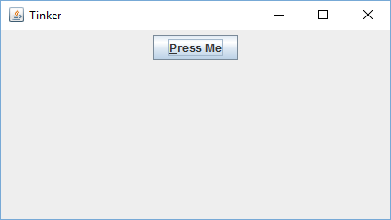
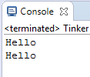
JButton
JButton bt = new JButton("Press Me");
bt.setToolTipText("This will do something amazing");
bt.setMnemonic('P');
bt.setEnabled(true);
bt.setIcon( ... );
bt.addActionListener( ... );
bt.addActionListener(new SayHello());
JPanel jp = new JPanel();
jp.add(bt);
class SayHello implements ActionListener {
@Override
public void actionPerformed(ActionEvent e) {
System.out.println("Hello");
}
}

Slide 5
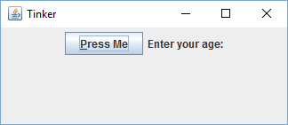
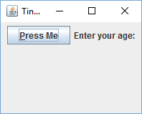
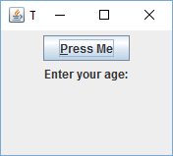
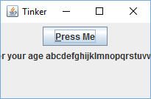
JLabel
JLabel lab = new JLabel("Enter your age:");
lab.setFont( ... );
lab.setIcon( ... );
JPanel jp = new JPanel();
jp.add(bt);
jp.add(lab);

Slide 6
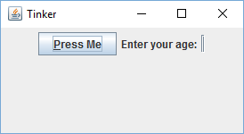
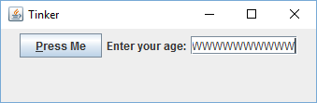
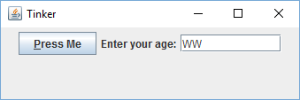
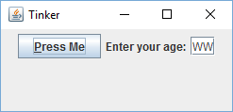
JTextField
JTextField tf = new JTextField();
JTextField tf = new JTextField(10);
JTextField tf = new JTextField("WW",10);
JTextField tf = new JTextField("WW");
tf.setText("A new value");
String g = tf.getText();
tf.setInputVerifier( ... );
JPanel jp = new JPanel();
jp.add(bt);
jp.add(lab);
jp.add(tf);

Slide 7
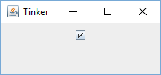
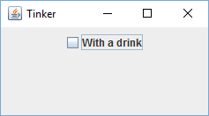
JCheckBox
JCheckBox cb = new JCheckBox();
JCheckBox cb = new JCheckBox(true);
JCheckBox cb = new JCheckBox("With a drink");
JCheckBox cb = new JCheckBox("With a drink",true);
cb.setSelected(true);
boolean b = cb.isSelected();
JPanel jp = new JPanel();
jp.add(cb);

Slide 8
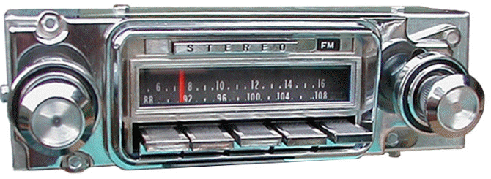
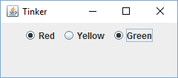
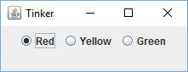
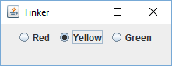
JRadioButton
JRadioButton ba = new JRadioButton("Red",true);
JRadioButton bb = new JRadioButton("Yellow");
JRadioButton bc = new JRadioButton("Green");
ButtonGroup bg = new ButtonGroup();
bg.add(ba);
bg.add(bb);
bg.add(bc);
bc.setSelected(true);
boolean b = ba.isSelected();
JPanel jp = new JPanel();
jp.add(ba);
jp.add(bb);
jp.add(bc);

Slide 9
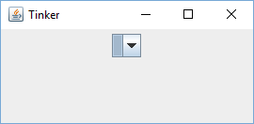
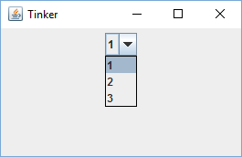
JComboBox
JComboBox cb = new JComboBox();
JComboBox<Integer> cb = new JComboBox<Integer>();
cb.addItem(1);
cb.addItem(2);
cb.addItem(3);
cb.setSelectedIndex(2);
int ind = cb.getSelectedIndex();
int val = (int) cb.getSelectedItem();
JPanel jp = new JPanel();
jp.add(cb);

Slide 10
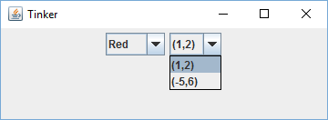
JComboBox
JComboBox<String> cb = new JComboBox<String>();
cb.addItem("Red");
cb.addItem("Yellow");
cb.addItem("Green");
JComboBox<Point> cp = new JComboBox<Point>();
cp.addItem(new Point(1,2));
cp.addItem(new Point(-5,6));
Point p = (Point) cp.getSelectedItem();
cp.setModel( ... );

Slide 11
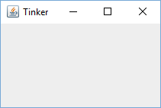
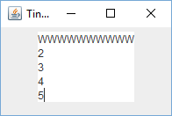
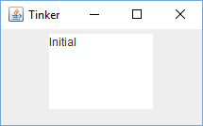
JTextArea
JTextArea ta = new JTextArea();
JTextArea ta = new JTextArea(5,10);
JTextArea ta = new JTextArea("Initial",5,10);
JPanel jp = new JPanel();
jp.add(ta);
ta.setText("HELLO\nWORLD\n");
String c = ta.getText();
ta.append("More");

Slide 12
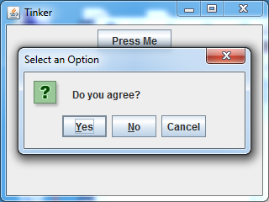
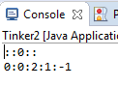
JOptionPane
JButton bt = new JButton("Press Me");
JPanel jp = new JPanel();
jp.add(bt);
JFrame jf = new JFrame("Tinker");
jf.setDefaultCloseOperation(JFrame.DISPOSE_ON_CLOSE);
jf.setContentPane(jp);
jf.setSize(640,480);
jf.setVisible(true);
int btnumber = JOptionPane.showConfirmDialog(jf, "Do you agree?");
System.out.println("::"+btnumber+"::");
System.out.println(JOptionPane.OK_OPTION+
":"+JOptionPane.YES_OPTION+
":"+JOptionPane.CANCEL_OPTION+
":"+JOptionPane.NO_OPTION+
":"+JOptionPane.CLOSED_OPTION);

Slide 13
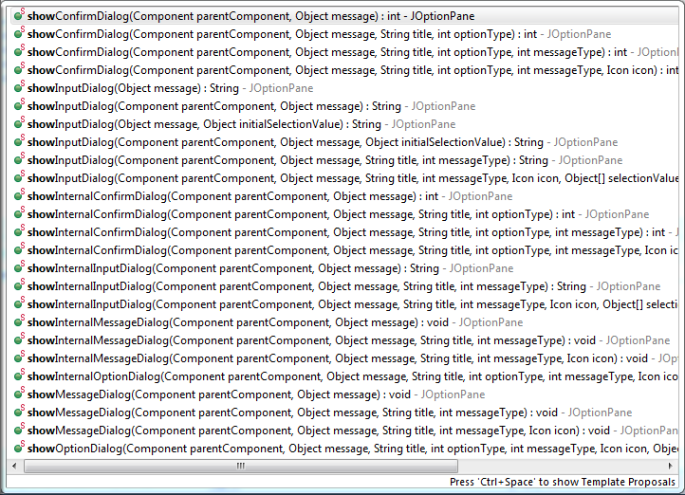
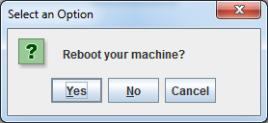
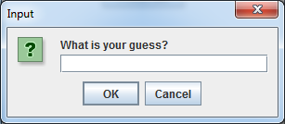
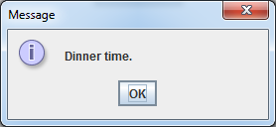
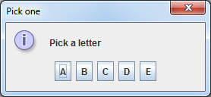

Slide 14
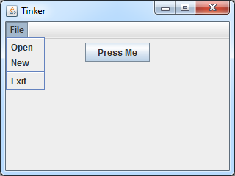
JMenu
JMenu fileMenu = new JMenu("File");
fileMenu.add(new JMenuItem("Open"));
fileMenu.add(new JMenuItem("New"));
fileMenu.addSeparator();
fileMenu.add(new JMenuItem("Exit"));
JMenuBar menuBar = new JMenuBar();
menuBar.add(fileMenu);
JFrame jf = new JFrame("Tinker");
...
jf.setJMenuBar(menuBar);

Slide 15

Tinkering
Create a basic frame and experiment with the components in this lesson.
Create the components for our “Length Conversion” program in the last lesson. Just add them to a frame for now. We’ll add layouts in the next lesson.

